Slide 4
I believe in God, the Father almighty,
Creator of heaven and earth,

Slide 5
and in Jesus Christ, his only Son, our Lord,

Slide 6
who was conceived by the Holy Spirit, born of the Virgin Mary, suffered under Pontius Pilate,

Slide 7
was crucified, died and was buried;

Slide 8
he descended into hell; on the third day he rose again from the dead; he ascended into heaven,

Slide 9
and is seated at the right hand of God the Father almighty;

Slide 10
from there he will come to judge the living and the dead.

Slide 11
I believe in the Holy Spirit, the holy catholic Church, the communion of saints,

Slide 12
the forgiveness of sins, the resurrection of the body, and life everlasting.
Amen.

Slide 13
Our Father, who art in heaven, hallowed be your name;

Slide 14
your kingdom come; your will be done on earth as it is in heaven.

Slide 15
Give us this day our daily bread; and forgive us our trespasses

Slide 16
as we forgive those who trespass against us

Slide 17
and lead us not into temptation; but deliver us from evil. Amen.

Slide 18
Hail Mary, full of grace, the Lord is with you; blessed are you among women, and blessed is the fruit of your womb, Jesus.

Slide 19
Holy Mary, Mother of God, pray for us sinners, now and at the hour of our death. Amen.

Slide 20
Hail Mary, full of grace, the Lord is with you; blessed are you among women, and blessed is the fruit of your womb, Jesus.

Slide 21
Holy Mary, Mother of God, pray for us sinners, now and at the hour of our death. Amen.

Slide 22
Hail Mary, full of grace, the Lord is with you; blessed are you among women, and blessed is the fruit of your womb, Jesus.

Slide 23
Holy Mary, Mother of God, pray for us sinners, now and at the hour of our death. Amen.

Slide 24
Glory be to the father, and to the son, and to the Holy Spirit.

Slide 25
As it was in the beginning, is now and ever shall be, world without end. Amen.

Slide 26
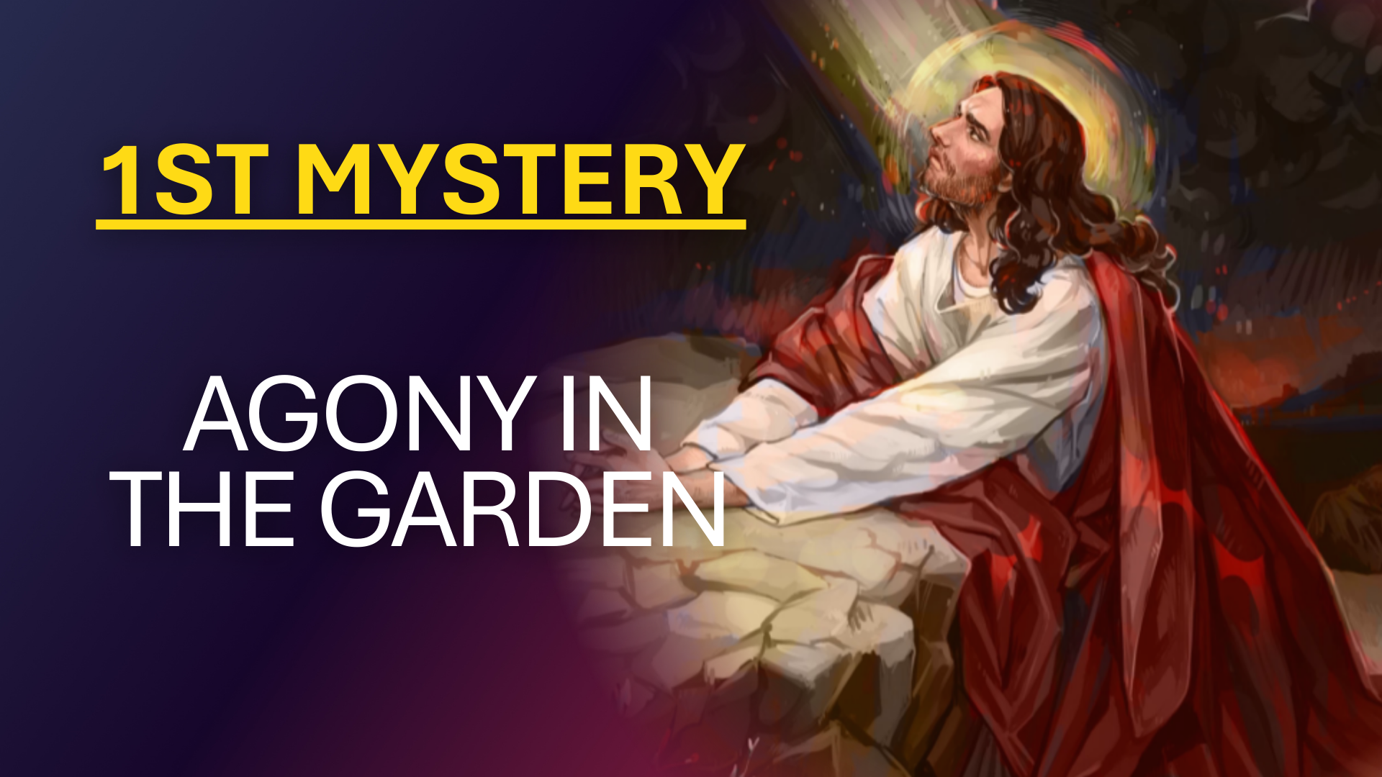

Slide 27
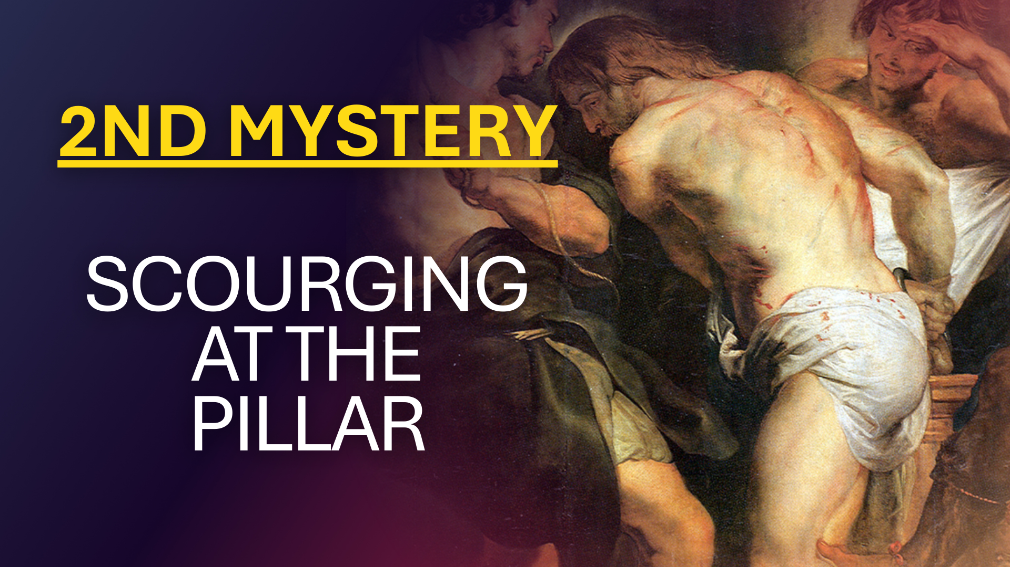

Slide 28
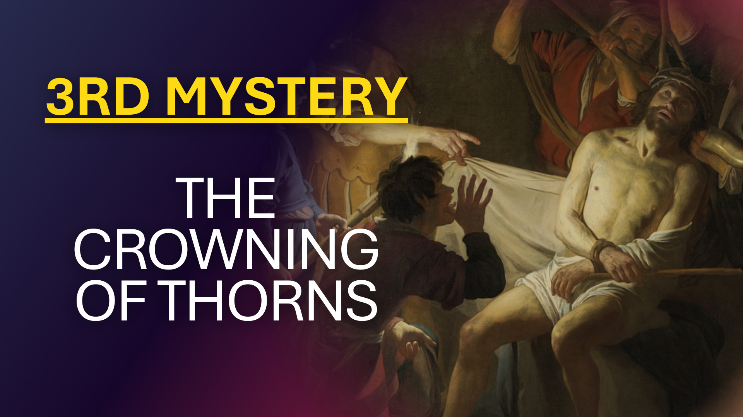

Slide 29
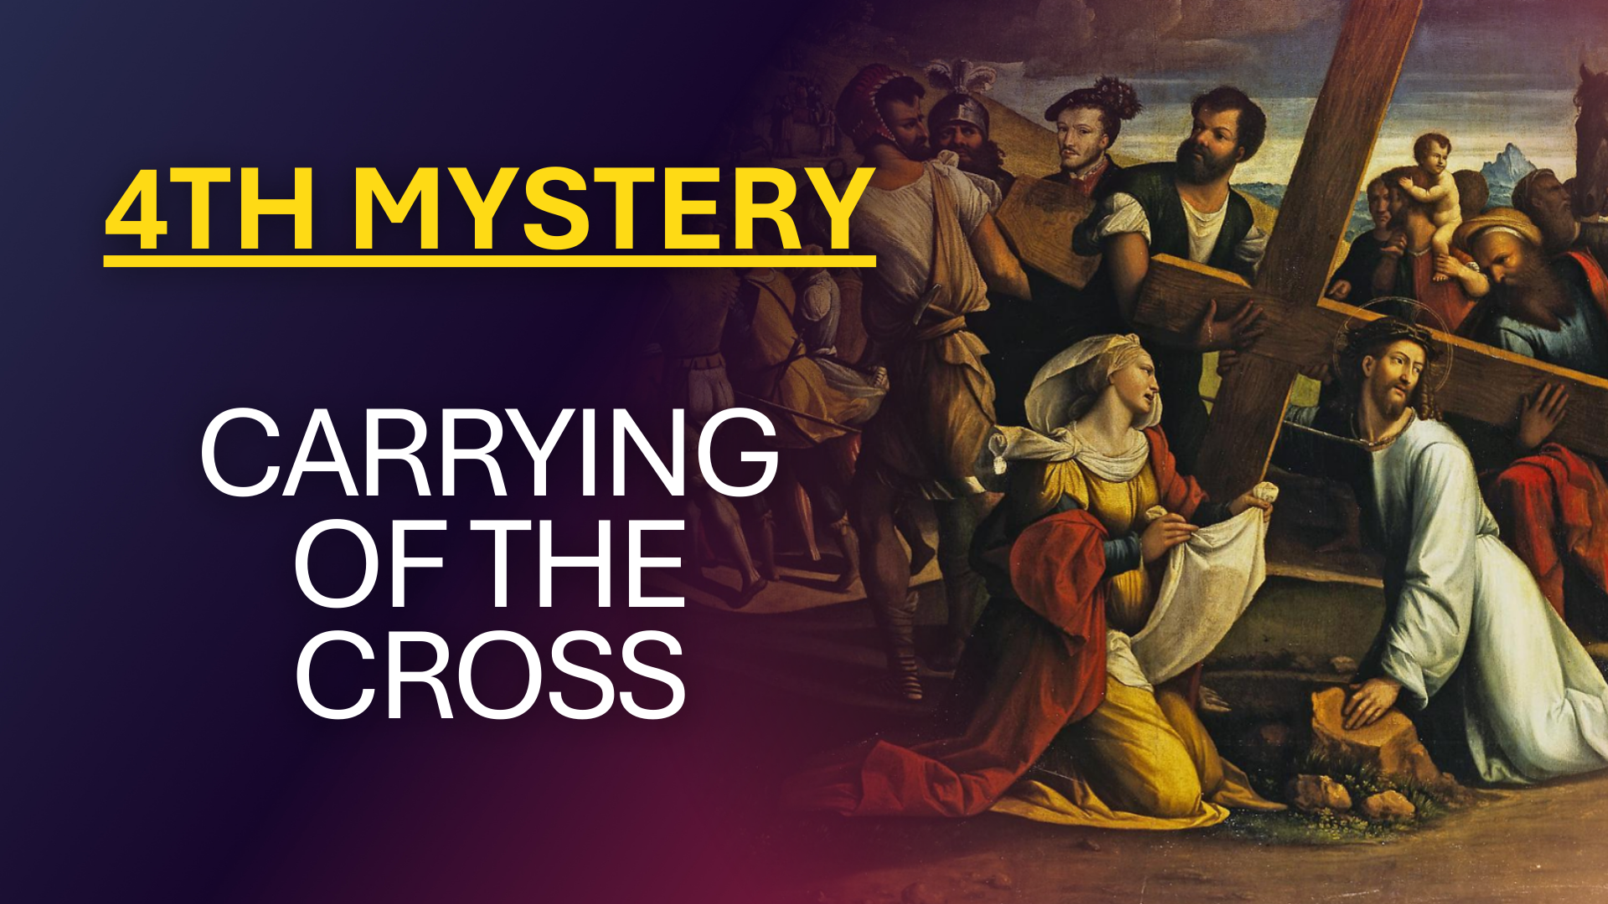

Slide 30
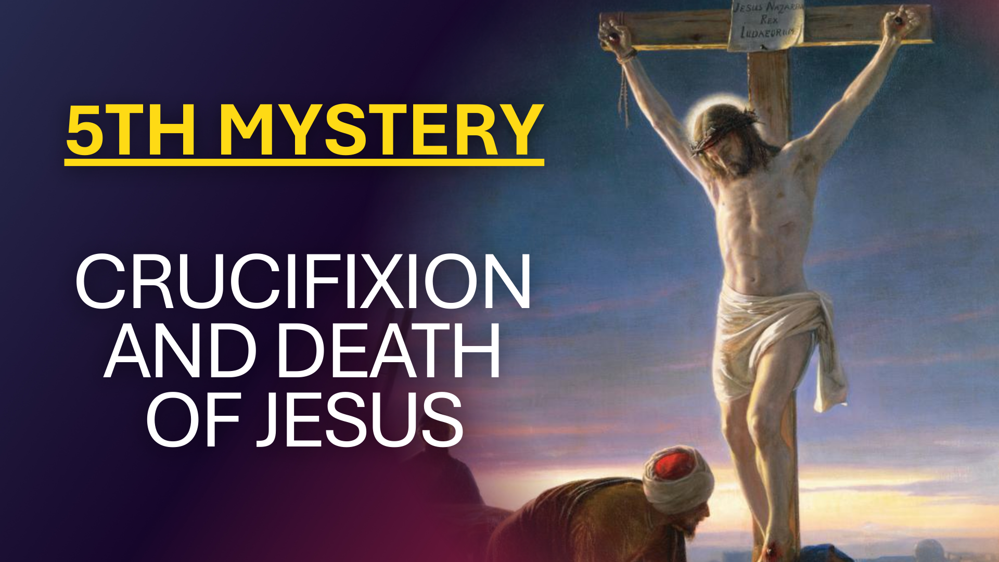

Slide 31
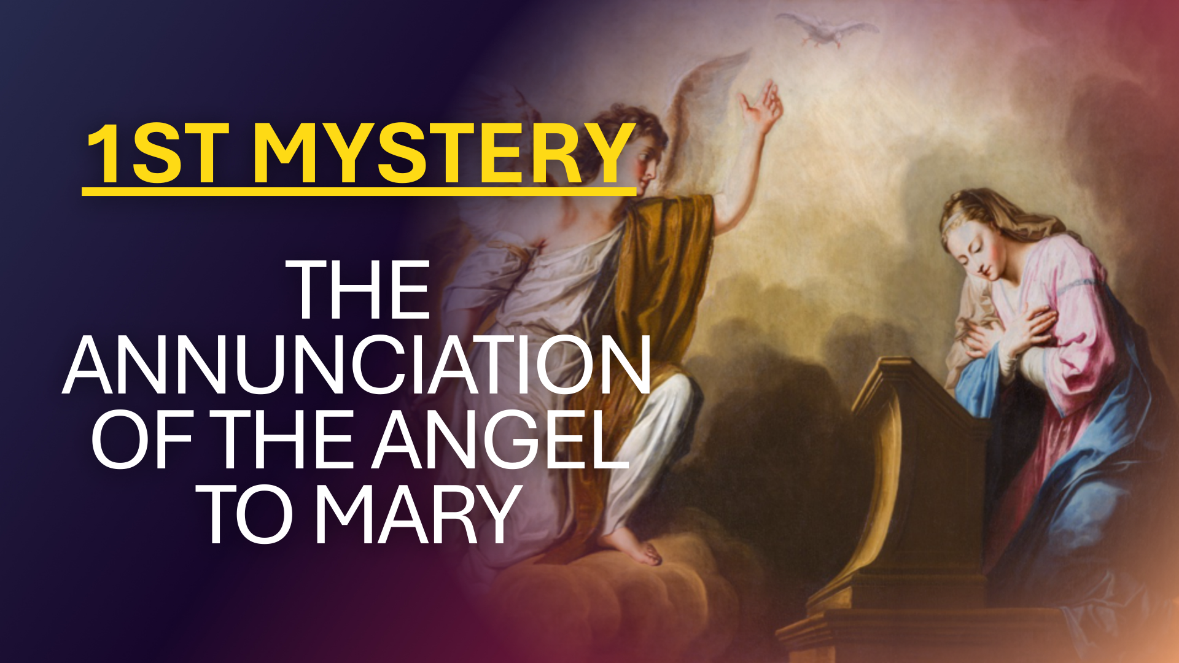

Slide 32
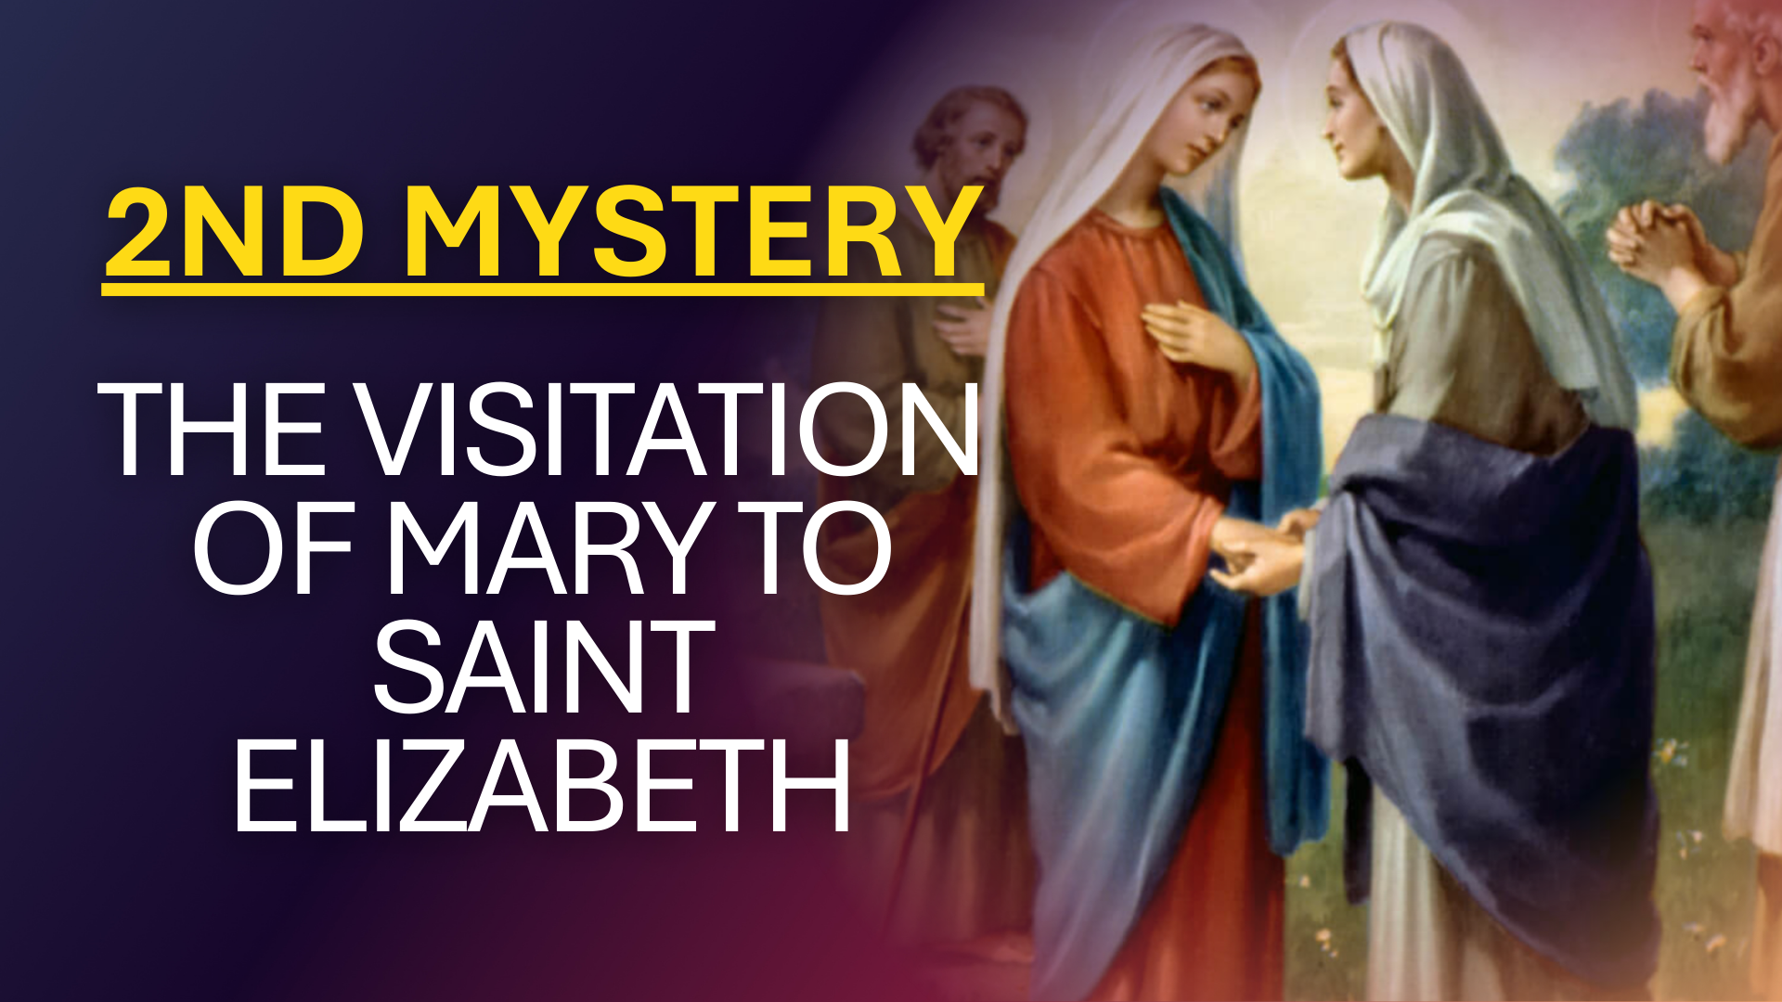

Slide 33
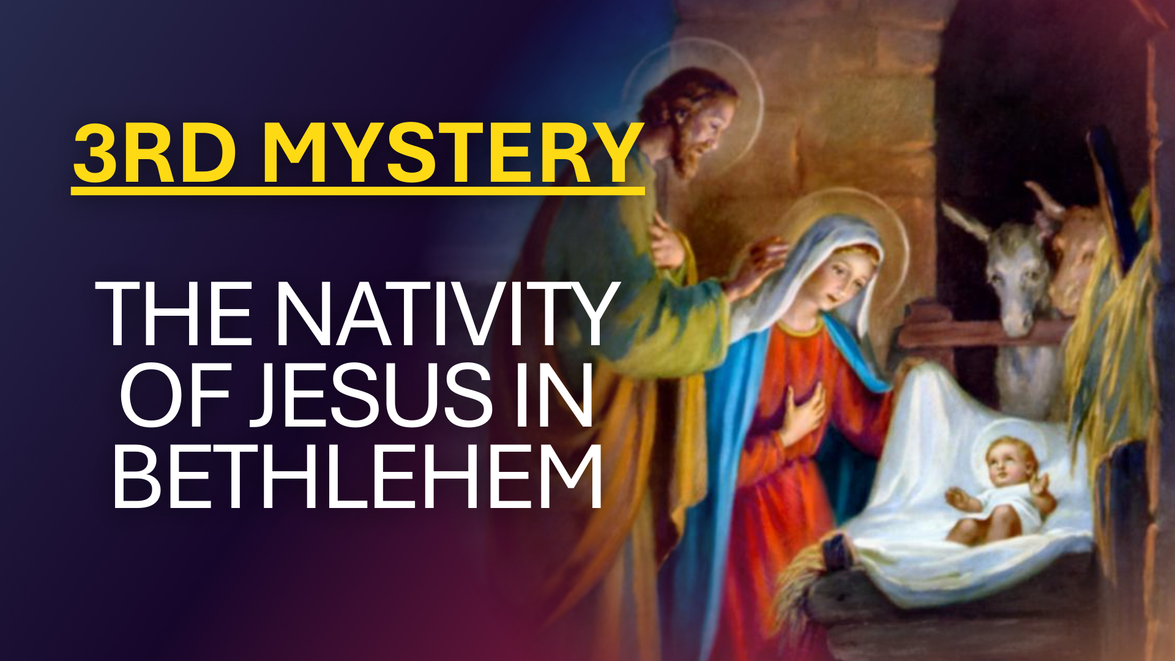

Slide 34
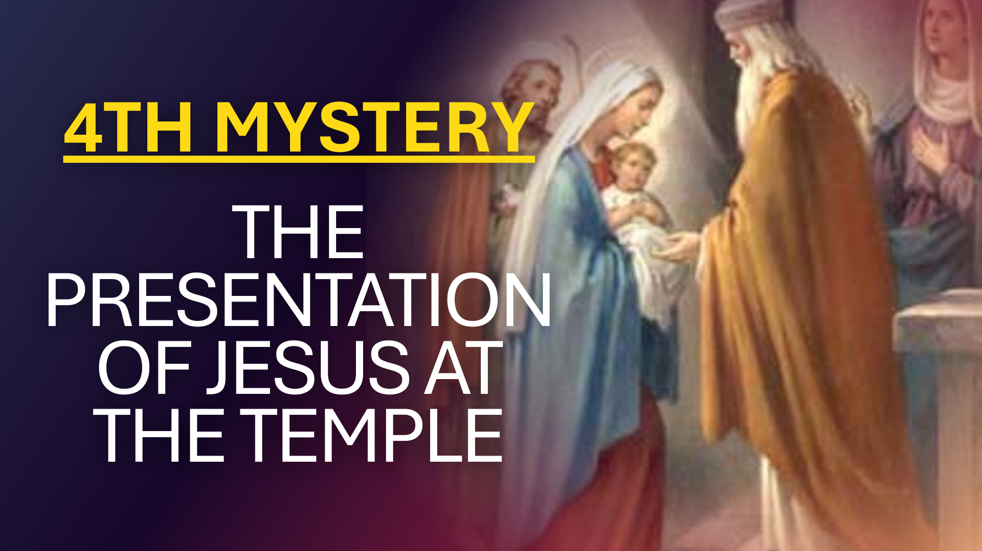

Slide 35
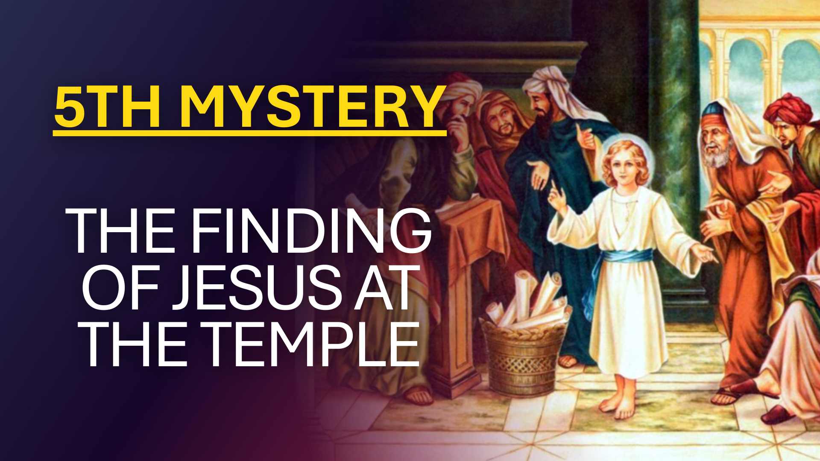

Slide 36
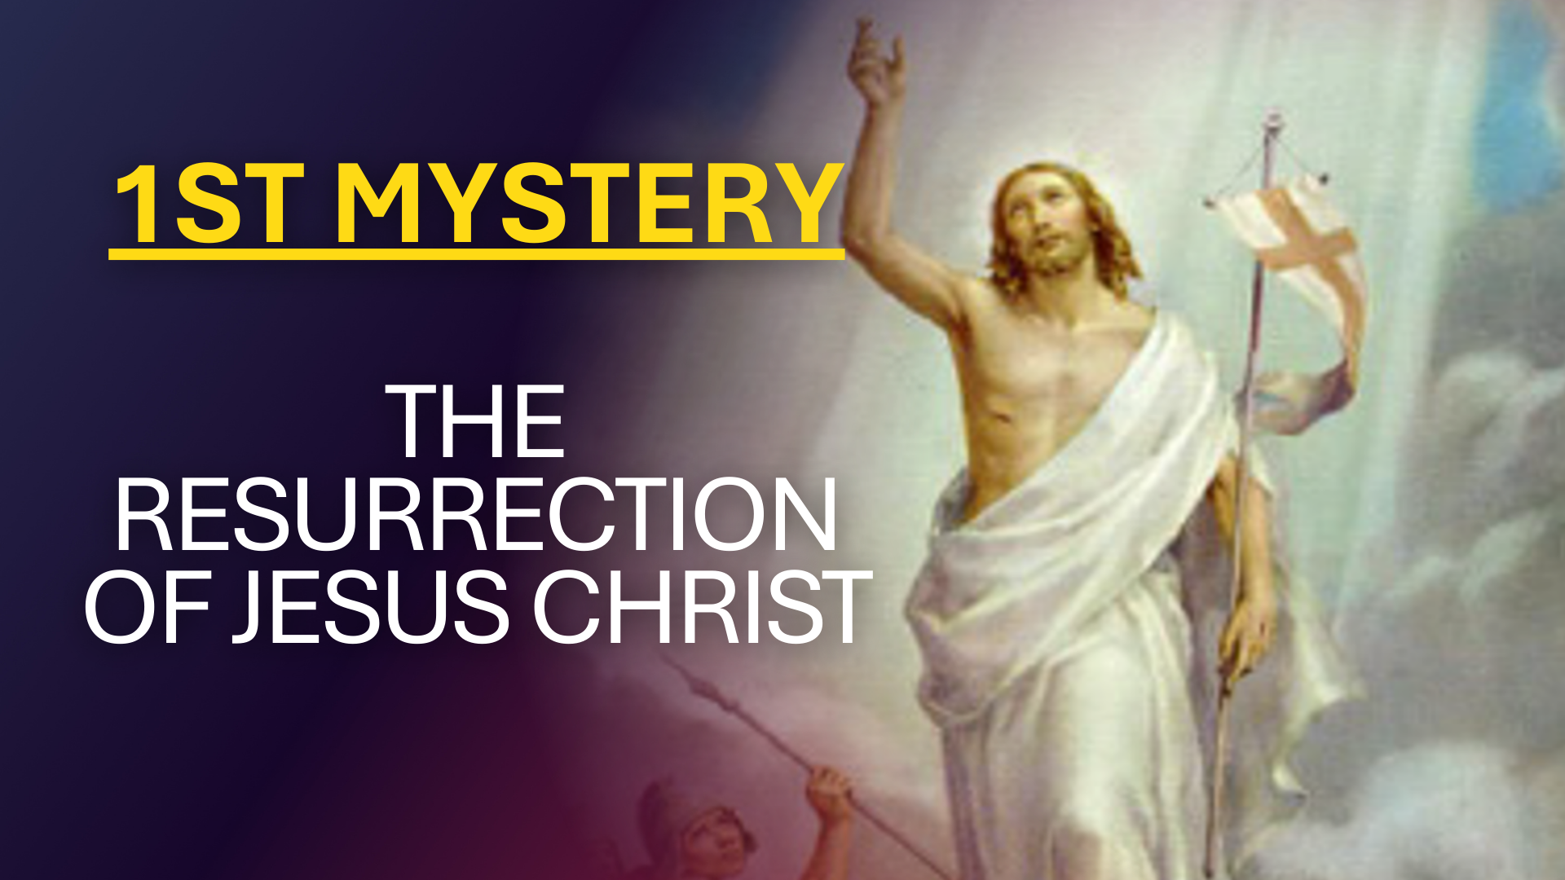

Slide 37
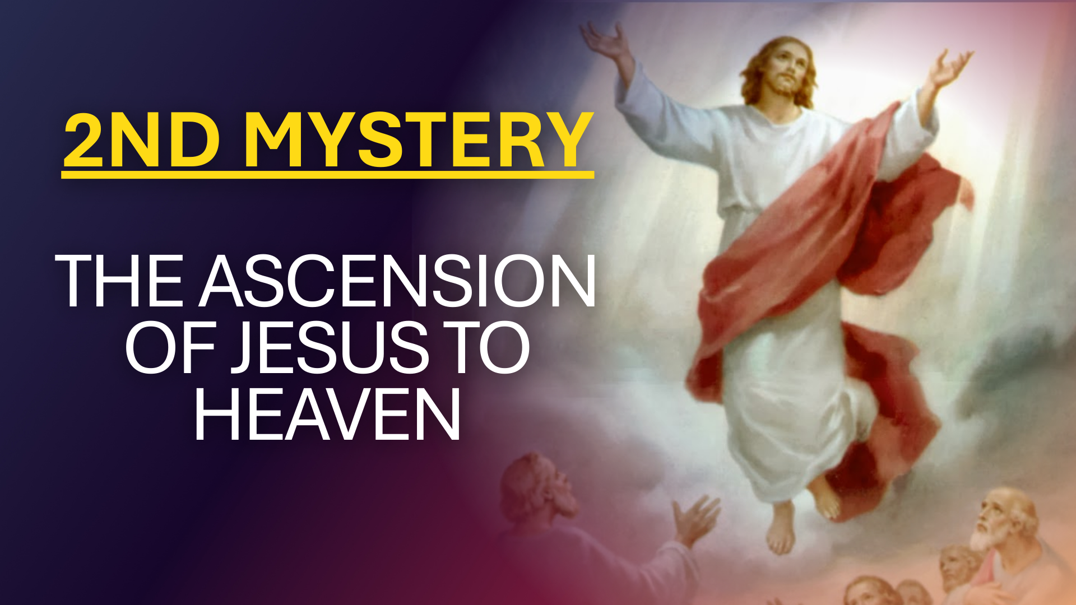

Slide 38
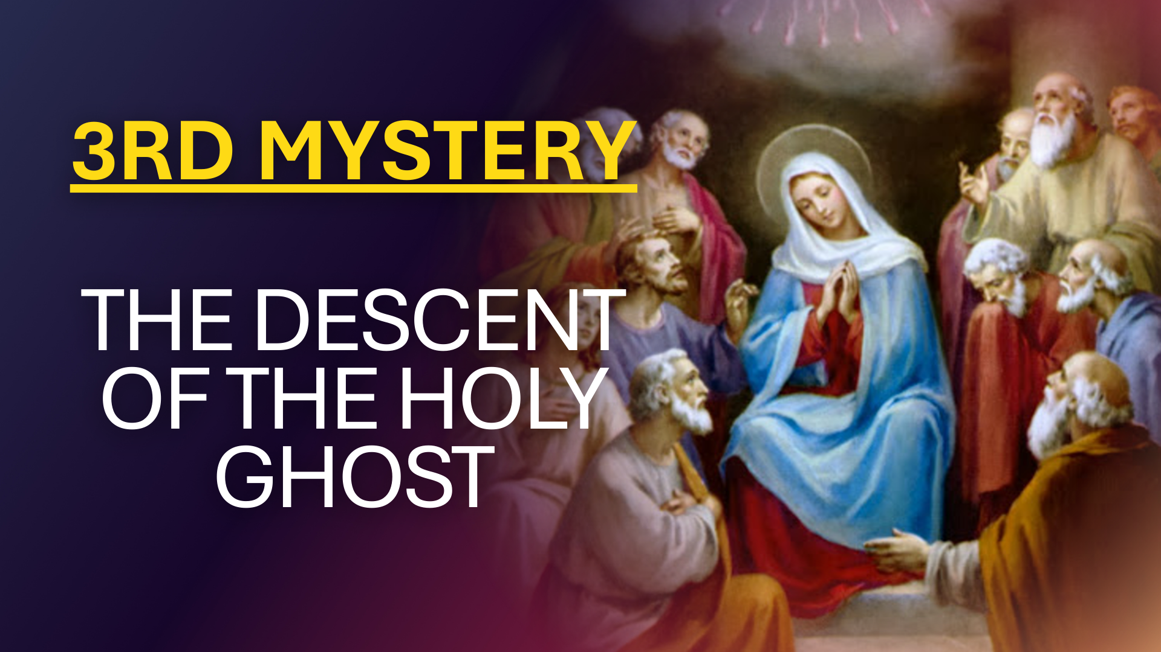

Slide 39
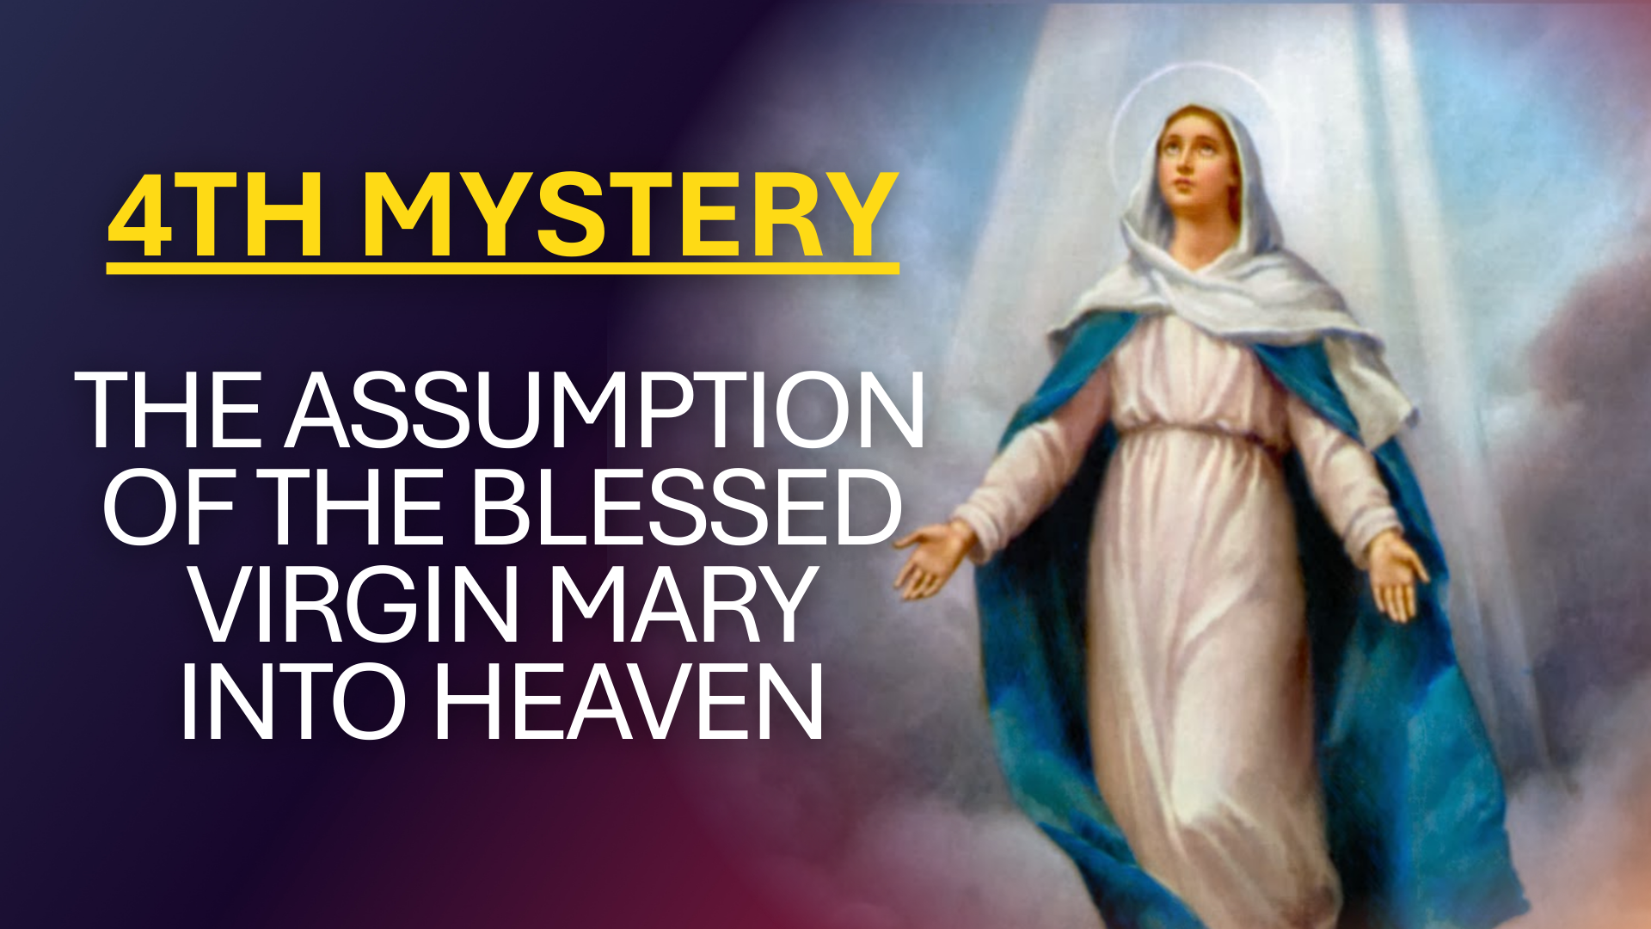

Slide 40
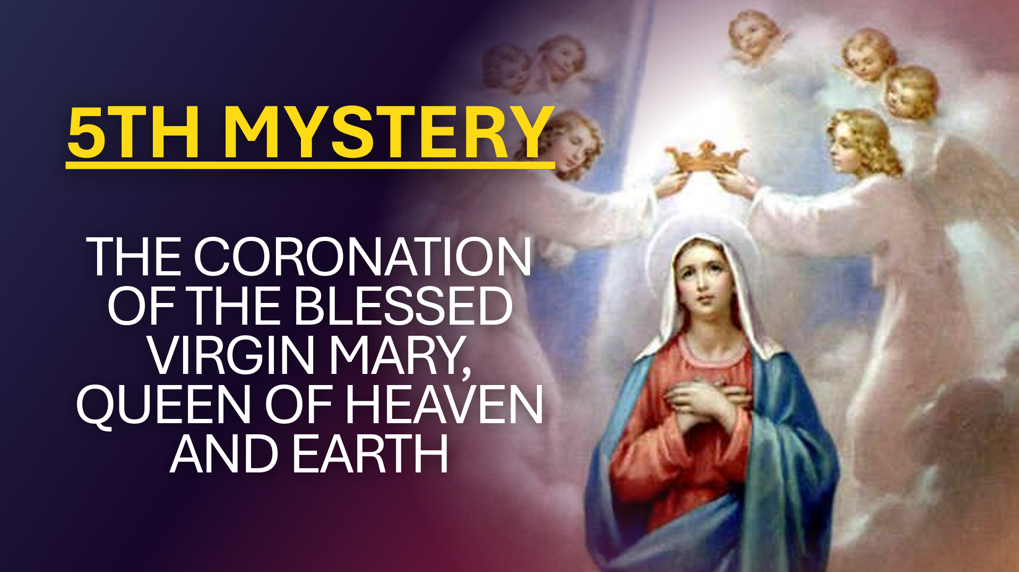

Slide 41
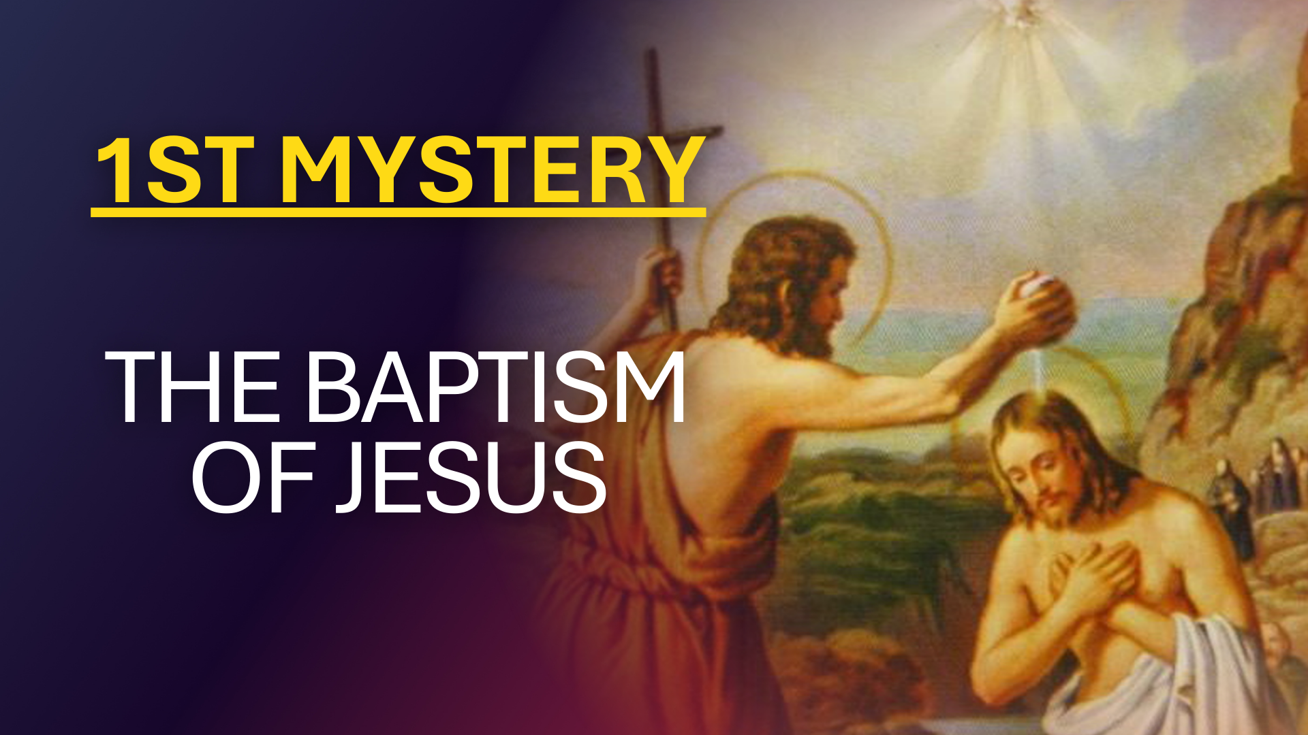

Slide 42
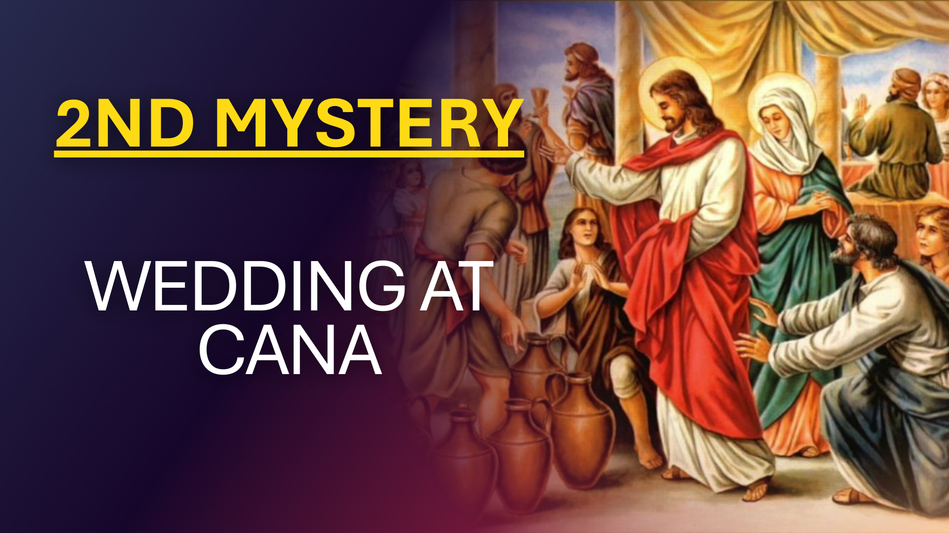

Slide 43
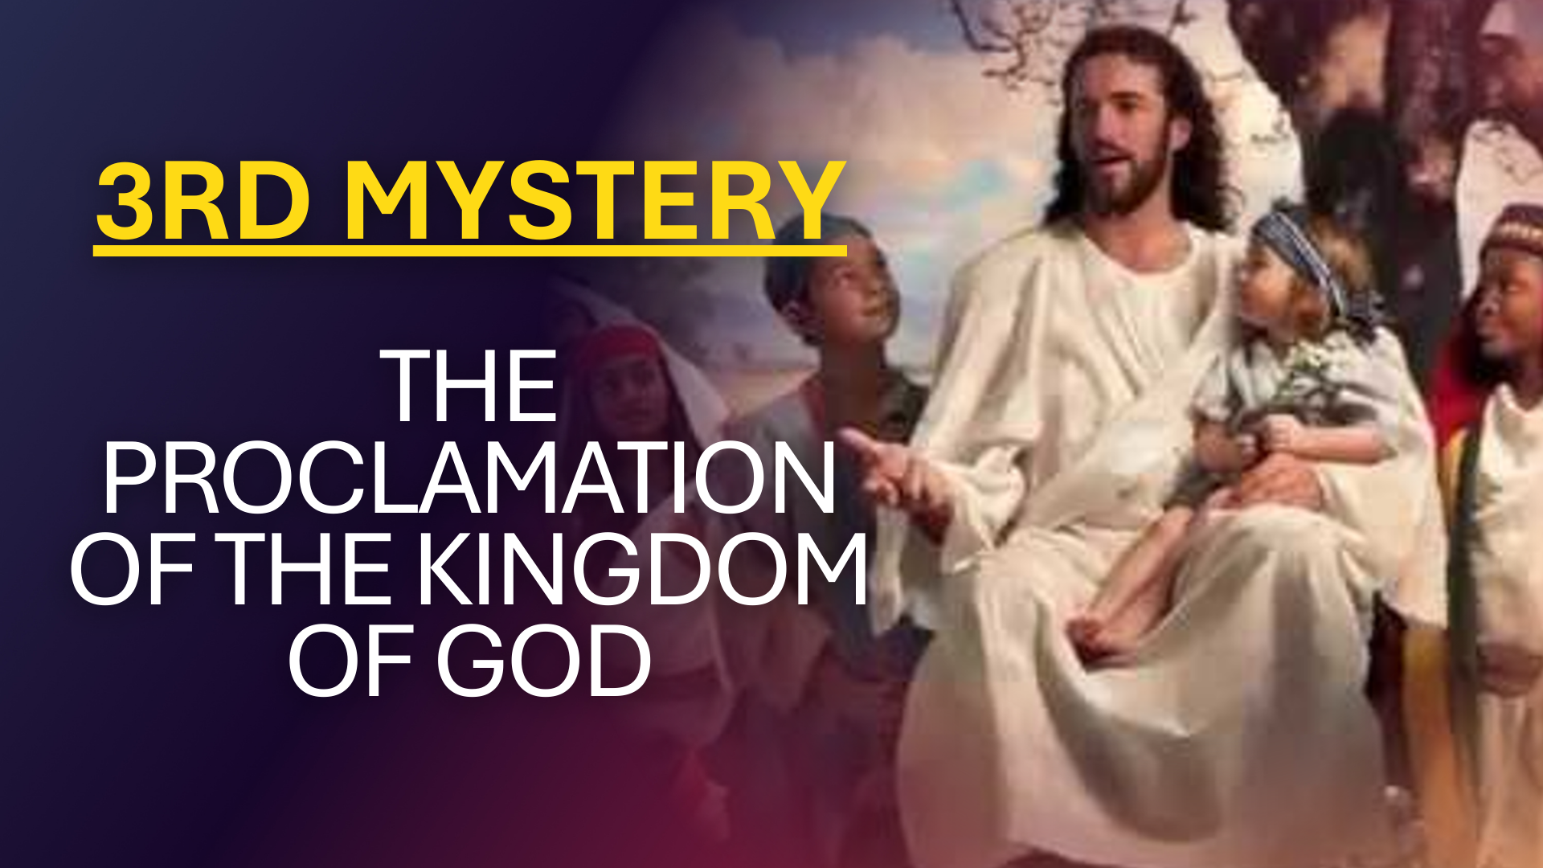

Slide 44
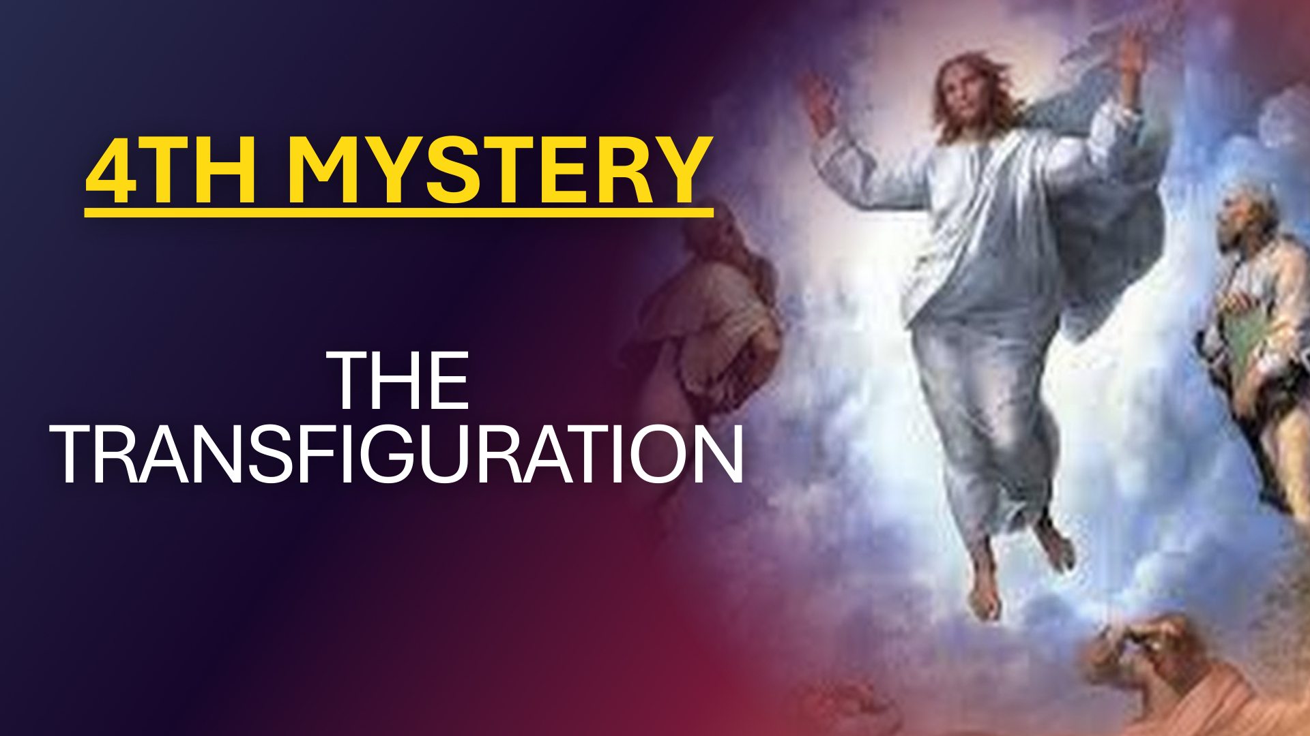

Slide 45
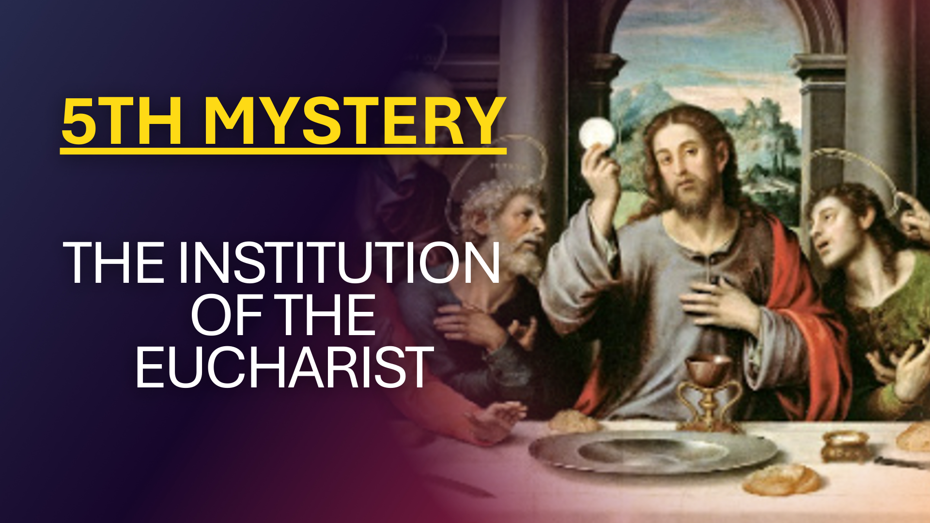

Slide 46
Please stand

Slide 47
Holy God, we praise Thy Name. Lord of all! We bow before Thee

Slide 48
All on earth Thy sceptre claim, All in heaven above adore thee;

Slide 49
Infinite Thy vast domain, Everlasting is Thy reign.

Slide 50
Hark! The loud celestial hymn, Angel’s choirs above are raising;

Slide 51
Cherubim and Seraphim In unceasing chorus praising

Slide 52
Fill the heavens with sweet accord, Holy, Holy, Holy Lord!

Slide 53
Fill the heavens with sweet accord, Holy, Holy, Holy Lord!

Slide 54
Oh, my dear Jesus! You are our King and our God

Slide 55
because of Your love for us, You came down from heaven born of the Virgin Mary

Slide 56
My heart weeps, for inspite of Your goodness, we have committed many sins

Slide 57
Forgive us, Oh Jesus, for our sin of ingratitude in return for Your goodness

Slide 58
Strengthen our will to resist temptation and sin.

Slide 59
With Your Grace we will be able to fulfil our promises and share Your glory in heaven.

Slide 60
Oh, Holy Child Jesus, who is ever good and loving,

Slide 61
we kneel before You, our true God

Slide 62
With humility we implore You
to give us Your mercy

Slide 63
and grant us all the favours we ask of You in this Novena

Slide 64
so that we will enjoy the blessings of heaven. AMEN.

Slide 65
Day 6 Petition Prayer
Oh, most-loving Jesus! You gave us an example

Slide 66
Day 6 Petition Prayer
of a chaste life while you were on earth

Slide 67
Day 6 Petition Prayer
we implore you to grant us the virtue
of chastity

Slide 68
Day 6 Petition Prayer
so that we may always live a chaste life

Slide 69
Day 6 Petition Prayer
in whatever state of life we have chosen

Slide 70
Day 6 Petition Prayer
This we ask you in your holy name. AMEN.

Slide 71
Following
x3 Our Father
x3 Hail Mary
x3 Glory Be

Slide 72
In silence –
Now ask Senor Santo Nino to hear your prayers and grant your petitions in this Novena

Slide 73
Supplications to SEÑOR SANTO NIÑO
Leader, then all:
Lord, Have mercy on us

Slide 74
Supplications to SEÑOR SANTO NIÑO
Leader, then all:
Christ, have mercy on us

Slide 75
Supplications to SEÑOR SANTO NIÑO
Leader, then all:
Lord, Have mercy on us

Slide 76
Supplications to SEÑOR SANTO NIÑO
Leader, then all:
Jesus, hear us

Slide 77
Supplications to SEÑOR SANTO NIÑO
Leader, then all:
Jesus, graciously hear us

Slide 78
Supplications to SEÑOR SANTO NIÑO
Leader:
In every need let us come to you with humble trust

Slide 79
Supplications to SEÑOR SANTO NIÑO
ALL: Santo Niño help us.

Slide 80
Supplications to SEÑOR SANTO NIÑO
Leader:
In all our doubts, perplexities, and temptations,

Slide 81
Supplications to SEÑOR SANTO NIÑO
ALL: Santo Niño help us.

Slide 82
Supplications to SEÑOR SANTO NIÑO
Leader:
In hours of loneliness, weariness and trials,

Slide 83
Supplications to SEÑOR SANTO NIÑO
ALL: Santo Niño help us.

Slide 84
Supplications to SEÑOR SANTO NIÑO
Leader: In the failure of our plans and hopes,

Slide 85
Supplications to SEÑOR SANTO NIÑO
ALL: Santo Niño help us.

Slide 86
Supplications to SEÑOR SANTO NIÑO
Leader:
In disappointments, troubles and sorrows,

Slide 87
Supplications to SEÑOR SANTO NIÑO
ALL: Santo Niño help us.

Slide 88
Supplications to SEÑOR SANTO NIÑO
Leader:
When others fail us, and your Grace alone can assist us

Slide 89
Supplications to SEÑOR SANTO NIÑO
ALL: Santo Niño help us.

Slide 90
Supplications to SEÑOR SANTO NIÑO
Leader:
When we throw ourselves on Your Tender Love as our only Refuge

Slide 91
Supplications to SEÑOR SANTO NIÑO
ALL: Santo Niño help us.

Slide 92
Supplications to SEÑOR SANTO NIÑO
Leader:
When our heart is cast down by failure

Slide 93
Supplications to SEÑOR SANTO NIÑO
ALL: Santo Niño help us.

Slide 94
Supplications to SEÑOR SANTO NIÑO
Leader:
When we are ill and our head and hands cannot
work and we are lonely

Slide 95
Supplications to SEÑOR SANTO NIÑO
ALL: Santo Niño help us.

Slide 96
Supplications to SEÑOR SANTO NIÑO
Leader:
When we feel impatient, and our cross irritates us

Slide 97
Supplications to SEÑOR SANTO NIÑO
ALL: Santo Niño help us.

Slide 98
Supplications to SEÑOR SANTO NIÑO
Leader:
Always, always, in spite of weakness, falls and
shortcomings of any kind

Slide 99
Supplications to SEÑOR SANTO NIÑO
ALL: Santo Niño help us.

Slide 100
Supplications to SEÑOR SANTO NIÑO
Leader:
Lamb of God, who takes away the sins of the world

Slide 101
Supplications to SEÑOR SANTO NIÑO
ALL:
Spare us, O Jesus.

Slide 102
Supplications to SEÑOR SANTO NIÑO
Leader:
Lamb of God, who takes away the sins of the world

Slide 103
Supplications to SEÑOR SANTO NIÑO
ALL:
Graciously hear us,
O Jesus.

Slide 104
Supplications to SEÑOR SANTO NIÑO
Leader:
Lamb of God, who takes away the sins of the world

Slide 105
Supplications to SEÑOR SANTO NIÑO
ALL:
Have mercy upon us,
O Jesus.

Slide 106
Supplications to SEÑOR SANTO NIÑO
Leader:
Jesus, hear us!

Slide 107
Supplications to SEÑOR SANTO NIÑO
ALL:
Now and forever!

Slide 108
Supplications to SEÑOR SANTO NIÑO
Leader:
Jesus, graciously hear us!

Slide 109
Supplications to SEÑOR SANTO NIÑO
ALL:
Now and forever!

Slide 110
Supplications to SEÑOR SANTO NIÑO
Leader:
Praise be the name of the Lord!

Slide 111
Supplications to SEÑOR SANTO NIÑO
ALL:
Now and forever!

Slide 112
Supplications to SEÑOR SANTO NIÑO
Leader:
Let us Pray!

Slide 113
Supplications to SEÑOR SANTO NIÑO
Oh, sweet and merciful Jesus! Senor Santo Nino

Slide 114
Supplications to SEÑOR SANTO NIÑO
the source of all goodness, we kneel before Your sacred Image

Slide 115
Supplications to SEÑOR SANTO NIÑO
imploring Your Divine Aid for universal peace

Slide 116
Supplications to SEÑOR SANTO NIÑO
and brotherhood of all men

Slide 117
Supplications to SEÑOR SANTO NIÑO
enlighten the unbelievers and the heathens

Slide 118
Supplications to SEÑOR SANTO NIÑO
so that they will believe you as their true God.

Slide 119
Supplications to SEÑOR SANTO NIÑO
Restore the faith of those who have wandered away from you

Slide 120
Supplications to SEÑOR SANTO NIÑO
bring them back to your fold with repentance in their hearts

Slide 121
Supplications to SEÑOR SANTO NIÑO
Grant also to faithful departed in Purgatory

Slide 122
Supplications to SEÑOR SANTO NIÑO
the remission of all their sins so that they will rest in peace forever

Slide 123
Supplications to SEÑOR SANTO NIÑO
Finally, nourish and strengthen our faith in You

Slide 124
Supplications to SEÑOR SANTO NIÑO
so that we will serve You faithfully on earth. AMEN

Slide 125
Lord Jesus, look kindly on my work and the work of my friends today.

Slide 126
Help me in my difficulties and decisions

Slide 127
May this candle be a light for you to enlighten me.

Slide 128
May it be a fire for you to burn out of me all pride, selfishness and impurity

Slide 129
May it be a flame for you to bring warmth into my heart;

Slide 130
warmth towards my family, my neighbours and all whom I meet.

Slide 131
Jesus, through the hands of Mary, Virgin and Mother

Slide 132
I place in your care, this, my special intention…

Slide 133
In silence –
Share your prayer request to the Lord

Slide 134
By sharing this candle, I wish to give

Slide 135
you something of myself; the love of my heart

Slide 136
Jesus, help me to live close to you in prayer today.

Slide 137
Thank you, Jesus, thank you, Mary. Amen.

Slide 138
One day to these islands As gift and in pledge

Slide 139
God sent You to us
O beloved Child And always You have been

Slide 140
The light of our souls
The guide of our people
The flame in our hearts

Slide 141
Senõr Santo Niño with Your sceptre guide our people

Slide 142
who hail you King forever Filipinas is Your kingdom

Slide 143
Senõr Santo Niño In Your hand the World finds it’s rest

Slide 144
proclaim Your truth and justice
Bring to men your peace and love

Slide 145
The ship You were sailing arrived at our shores

Slide 146
To conquer this land
The Pearl of the seas

Slide 147
But You had decided
To stay in this soil

Slide 148
To conquer our people And give us a name.

Slide 149
Senõr Santo Niño with Your sceptre guide our people

Slide 150
who hail you King forever Filipinas is Your kingdom

Slide 151
Senõr Santo Niño In Your hand the World finds it’s rest

Slide 152
proclaim Your truth and justice
Bring to men your peace and love

Slide 153
The queen and the Rajah Accepting the faith

Slide 154
Received You in their arms
And fell on their knees;

Slide 155
They welcomed your presence
And called on Your name

Slide 156
To ask for Your blessing And help in their needs

Slide 157
Senõr Santo Niño with Your sceptre guide our people

Slide 158
who hail you King forever Filipinas is Your kingdom

Slide 159
Senõr Santo Niño In Your hand the World finds it’s rest

Slide 160
proclaim Your truth and justice
Bring to men your peace and love

Slide 161
More ships in the orient With soldiers arrived

Slide 162
And searching for gold They found You instead;

Slide 163
Legaspi, Urdaneta, the Rajah, the queen

Slide 164
Their subjects, our people Proclaimed You their King.

Slide 165
Senõr Santo Niño with Your sceptre guide our people

Slide 166
who hail you King forever Filipinas is Your kingdom

Slide 167
Senõr Santo Niño In Your hand the World finds it’s rest

Slide 168
proclaim Your truth and justice
Bring to men your peace and love

Slide 169
Now one as a nation
We pay You respect

Slide 170
Our people did pledge
A long time ago

Slide 171
We ask You to hear, the prayers of all
The sad and forsaken
The poor and the sick

Slide 172
Senõr Santo Niño with Your sceptre guide our people

Slide 173
who hail you King forever Filipinas is Your kingdom

Slide 174
Senõr Santo Niño In Your hand the World finds it’s rest

Slide 175
proclaim Your truth and justice
Bring to men your peace and love

Slide 177
O miraculous Santo Nino! Prostrate before your sacred Image

Slide 178
we beseech You to cast a merciful look on our troubled hearts

Slide 179
Let Your tender love, so inclined to pity, be softened at our prayers

Slide 180
and grant us the grace for which we ardently implore You

Slide 181
Take from us all unbearable affliction and despair

Slide 182
For Your sacred infancy’s sake

Slide 183
hear our prayers and send us consolation and aid

Slide 184
that we may praise You, with the Father
and the Holy Spirit, forever and ever. AMEN

