Slide 1
Template Instructions
Please email this finished template to technology.AV@acfc-catholic.org.nz at least two days before your scheduled day. This is to make sure that there is a backup of your PowerPoint.
You are to bring your own laptop to connect to the screens. But this must have an HDMI out connection
Please make sure that you update the readings and the prayer of the faithful responses

Slide 2
Template Instructions
Please make sure that you use the same size and style of how this template is created.
If you are going to copy from a website, or other resources, please do paste the song lyrics as text only, or use destination theme options.
Do not have more than three lines on this template per slide. If it goes over, please cut and paste the hanging content to a new slide and continue. For example, see the how Gloria Spoken is done.

Slide 3
Template Instructions
PLEASE DO NOT CHANGE THE ORDINARIES THAT HAS BEEN INCLUDED IN THIS PPT
BRINGING USB TO THE TECH BOOTH ON THE DAY OF YOUR SERVICE IS NOT ALLOWED
SINGING OF GLORIA IS OMITTED DURING THE SEASON OF LENT

Slide 4
Observe Silence
Please remain silent and join us by praying the rosary

Slide 6
[ENTRANCE SONG HERE]

Slide 8
Inaamin ko sa makapangyarihang Diyos
I confess to almighty God

Slide 9
at sa inyo mga kapatid na lubha akong nagkasala
That I have sinned and to you my brothers and sisters

Slide 10
(dadagok sa dibdib)
sa isip, sa salita, sa gawa,
in my thoughts, in my words, and what I have done

Slide 11
Pagsisisi
(dadagok sa dibdib)
at sa aking pagkukulang.
And what I have failed to do

Slide 12
Kaya isinasamo ko sa Mahal na Birheng Maria
I ask the blessed Mary, ever virgin

Slide 13
sa lahat ng mga anghel at mga banal
All the angels and the saints

Slide 14
at sa inyo, mga kapatid
And to you my brothers and sisters

Slide 15
na ako’y ipanalangin sa Panginoong Diyos.
To pray for me to the Lord our God.

Slide 17
Pagsisisi
Panginoon, kaawaan mo kami.
Lord, Have mercy

Slide 18
Pagsisisi
Kristo, kaawaan mo kami.
Christ, Have mercy

Slide 19
Pagsisisi
Panginoon, kaawaan mo kami.
Lord, Have mercy

Slide 21
Pagsisi
Pagsisi Song Here

Slide 23

[Enter verse here]

Slide 24
Salamat sa Diyos!
Thanks be to God!

Slide 26

[Enter Psalm Response
Here]

Slide 28

[Enter verse here]

Slide 29
Salamat sa Diyos!
Thanks be to God!

Slide 31
Papuri sa ‘Yo, O Kristo Hesus
Praise to You, Lord Jesus Christ

Slide 32
Hari ng kaluwalhatiang walang hanggan!
King of endless glory!

Slide 33
Luwalhati at Papuri sa’Yo
Glory and praise to You

Slide 34
Panginoong Hesukristo!
Lord Jesus Christ

Slide 35
AWIT-PAMBUNGAD SA MABUTING BALITA
Ang sabi ng Poong mahal, “Sa daigdig ako’y ilaw.

Slide 36
Kapag ako ay sinundan, ang dilim ay mapaparam at sa aki’y mabubuhay

Slide 37
HALINA’T TAYO’Y MAG-ALAY, KAY HESUS NA POONG MAHAL

Slide 38
NG PANANALIG NA TUNAY UPANG MAPAKINABANGAN

Slide 39
ANG DULOT NIYANG BAGONG TIPAN

Slide 40

[Enter gospel here]

Slide 42
Sumasampalataya ako
I believe

Slide 43
Sa Diyos Amang makapangyarihan sa lahat
in God the Father almighty

Slide 44
na may gawa ng langit at lupa
The maker of heaven and earth

Slide 45
Sumasampalataya ako kay Hesukristo
I believe in Jesus Christ

Slide 46
iisang Anak
ng Diyos, Panginoon nating lahat
His only Son, our Lord

Slide 47
Nagkatawang-tao siya lalang ng Espiritu Santo
Who was conceived by the Holy Spirit

Slide 48
ipinanganak ni Santa Mariang Birhen
Born of the Virgin Mary

Slide 49
Pinagpakasakit ni
Poncio Pilato,
Suffered under Pontius Pilate

Slide 50
ipinako sa krus,
namatay, inilibing
Was crucified, died and was buried.

Slide 51
Nanaog sa kinaroroonan ng mga Yumao
he descended into hell.

Slide 52
Nang may ikatlong
araw nabuhay na mag-uli
on the third day he rose again from the dead.

Slide 53
Umakyat sa langit
He ascended into heaven

Slide 54
Naluluklok sa kanan
is seated at the right hand

Slide 55
ng Diyos Amang makapangyarihan sa lahat
of God the Father almighty

Slide 56
Doon magmumula ang paririto at huhukom
From there he will come to judge

Slide 57
sa nangabubuhay
at nangamatay na tao
The living and the dead

Slide 58
Sumasampalataya naman ako sa Diyos Espiritu Santo
I believe in the Holy Spirit

Slide 59
Sa banal na Simbahang Katolika
the holy catholic Church

Slide 60
sa kasamahan ng mga banal
the communion of saints

Slide 61
sa kapatawaran ng mga kasalanan,
the forgiveness of sins

Slide 62
sa pagkabuhay na muli ng nangamatay na tao,
the resurrection of the body

Slide 63
at sa buhay na walang hanggan. Amen
and live everlasting. AMEN

Slide 65
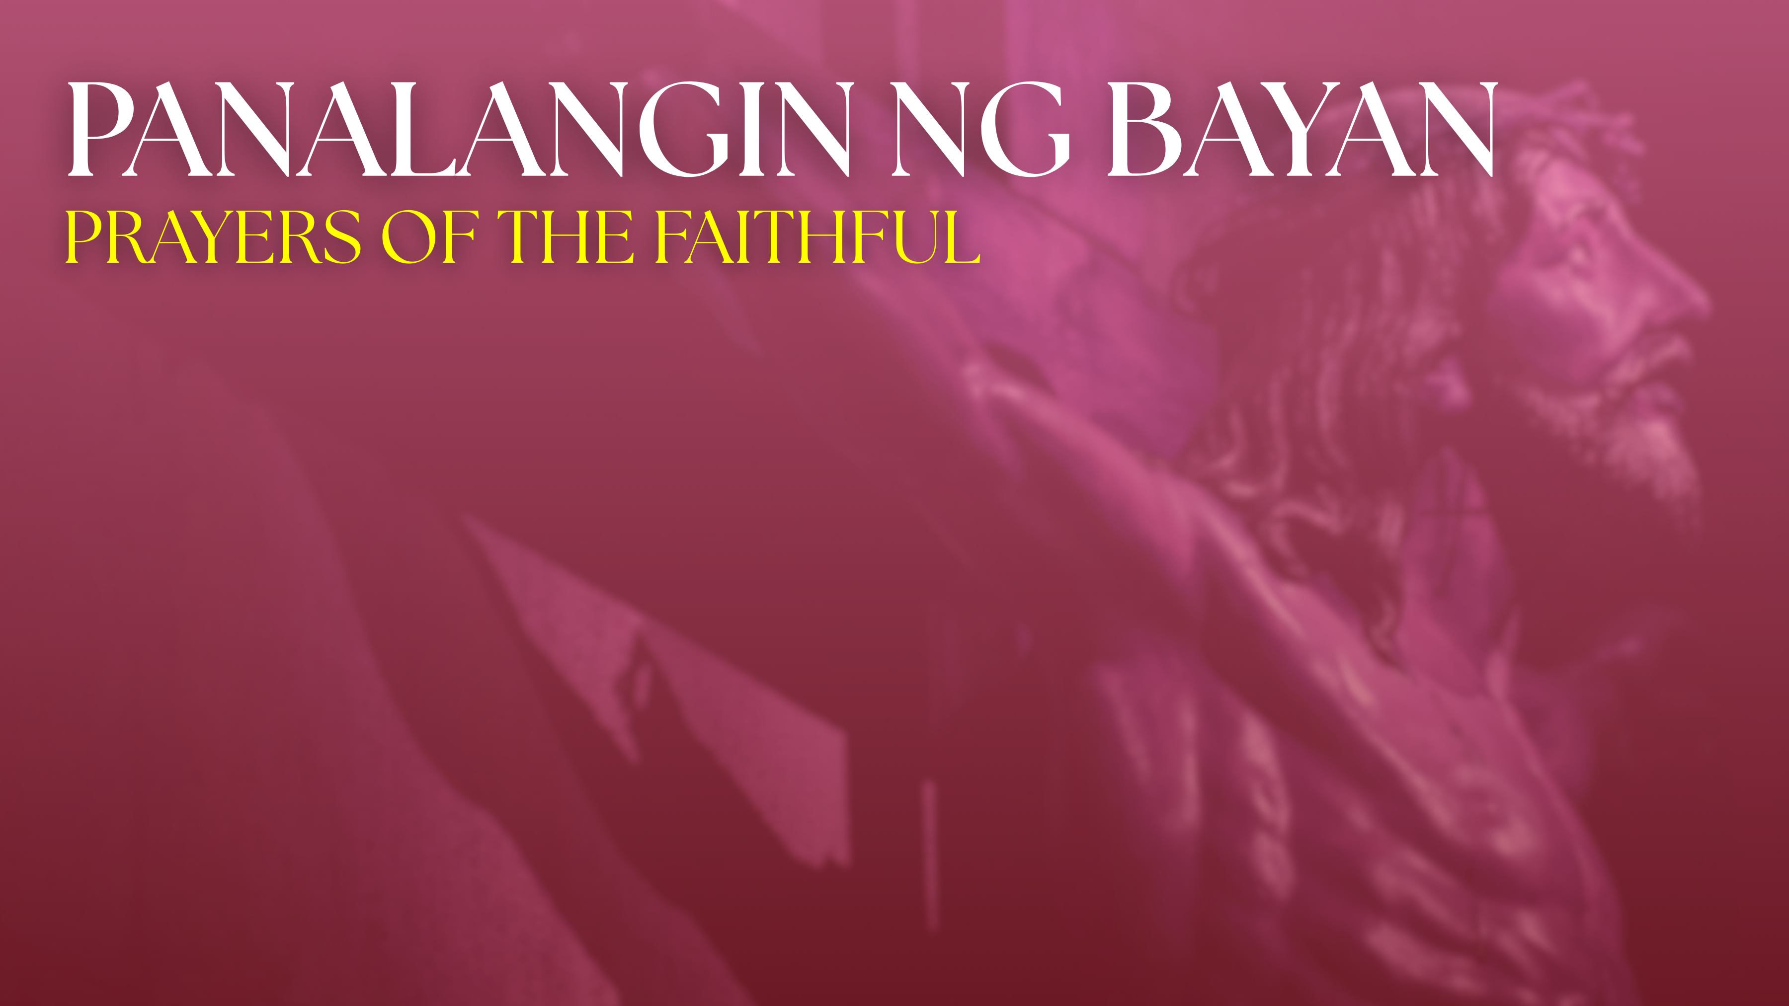
[Enter response here]

Slide 66
Aba Ginoong Maria, napupuno ka ng grasiya
Hail Mary, full of grace

Slide 67
Ang Panginoong Diyos ay sumasaiyo
the Lord is with thee

Slide 68
Bukod kang pinagpala sa babaeng lahat,
Blessed art thou among women

Slide 69
At pinagpala rin naman ang anak mong si Hesus
and blessed is the fruit of thy womb, Jesus.

Slide 70
Santa Maria, Ina ng Diyos
Holy Mary, Mother of God

Slide 71
Ipanalangin mo kaming makasalanan
pray for us sinners

Slide 72
Ngayon at kung kami'y mamamatay. AMEN
now and at the hour of our death. AMEN

Slide 74
OFFERTORY SONG TITLE HERE
Offertory Song Here

Slide 76
Tanggapin nawa ng Panginoon
May the Lord accept

Slide 77
itong paghahain sa iyong kamay
the sacrifice at your hands

Slide 78
Sa kapurihan niya at karangalan
For the praise and glory of HIS name

Slide 79
sa ating kapakinabangan
For our good

Slide 80
at sa buong
Sambayanan niyang banal
And the good of all HIS holy church

Slide 82
Lahat (All)
At Sumaiyo rin
And with your spirit

Slide 83
Lahat (All)
Itinaas na namin sa Panginoon
We lift them up to the LORD

Slide 84
Lahat (All)
Marapat na siya ay pasalamatan
It is right and just (to give Him thanks)

Slide 86
Santo, Santo, Santo
Holy, Holy, Holy

Slide 87
Diyos Makapangyarihan
Lord God of hosts

Slide 88
Puspos ng l’walhati ang langit at lupa
Heaven and earth are full of your glory

Slide 89
Hosana, hosana sa kaitaasan
Hosanna, Hosanna in the highest

Slide 90
Pinagpala ang narito sa ngalan ng Panginoon
Blesses is He who comes in the name of the LORD

Slide 91
Hosana, hosana sa kaitaasan
Hosanna, Hosanna in the highest

Slide 92
Hosana, hosana sa kaitaasan
Hosanna, Hosanna in the highest

Slide 94
Si Kristo ay gunitain
Let’s remember Christ

Slide 95
Sarili ay inihain
For HE has served Himself

Slide 96
Bilang pagkai’t inumin
As a meal for us to partake

Slide 97
Pinagsasaluhan natin
For us, HIS own people

Slide 98
Hanggang sa S’ya’y dumating
Until the time HE comes

Slide 99
Hanggang sa S’ya’y dumating
Until the time HE comes

Slide 100
Aming ipinahahayag
We declare

Slide 101
Na namatay ang ‘yong Anak
That your Son died

Slide 102
Nabuhay bilang Mesiyas
Lived as a messiah

Slide 103
At magbabalik sa wakas
And will return at last

Slide 104
upang maghayag sa lahat
to be revealed to all

Slide 105
Si Kristo’y namatay
Christ has died

Slide 106
Si Kristo’y nabuhay
Christ has risen

Slide 107
Si Kristo ay babalik sa wakas ng panahon
Christ will come again

Slide 108
Santo, Santo, Santo
Holy, Holy, Holy

Slide 109
Panginoong Diyos ng mga hukbo
Lord God of hosts

Slide 110
Napupuno ang langit at lupa ng kadakilaan mo
Heaven and earth are full of your glory

Slide 111
Osana, Osana sa kaitaasan
Hosanna, Hosanna in the highest

Slide 112
Pinagpala ang naparirito
Blessed is He who comes

Slide 113
Sa ngalan ng Panginoon
In the name of the Lord

Slide 114
Osana, Osana sa kaitaasan
Hosanna, Hosanna in the highest

Slide 116
Ama Namin,
sumasalangit ka.
Our Father, who art in heaven

Slide 117
Sambahin ang ngalan mo
Hallowed be thy name

Slide 118
Mapasaamin ang
kaharian Mo
Thy kingdom come

Slide 119
Sundin ang loob mo dito sa lupa
Thy will be done on earth

Slide 120
para nang sa langit
as it is in heaven

Slide 121
Bigyan mo kami ngayon
Give us this day

Slide 122
ng aming kakanin sa araw-araw
our daily bread

Slide 123
At patawarin mo kami sa aming mga sala
and forgive us our trespasses

Slide 124
Para nang pagpapatawad namin sa nagkakasala sa amin
as we forgive those who trespass against us

Slide 125
At huwag mo kaming ipahintulot sa tukso
And lead us not into temptation

Slide 126
At iadya mo kami sa lahat ng masama
but deliver us from evil.

Slide 128
Sapagkat sa’yo ang kaharian
For the the kingdom

Slide 129
Kapangyarihan, at kapurihan
The power and glory are yours

Slide 130
magpakailanman
Now and forever

Slide 131
Sapagkat sa’yo ang kaharian
For the the kingdom

Slide 132
Kapangyarihan, at kapurihan
The power and glory are yours

Slide 133
Ngayon at magpakailanman
Now and forever

Slide 135
Kordero ng Diyos, na nag-aalis
Lamb of God who takes away

Slide 136
ng mga kasalanan ng sanlibutan
the sins of the world

Slide 137
Maawa ka sa amin
Have mercy on us

Slide 138
Kordero ng Diyos, na nag-aalis
Lamb of God who takes away

Slide 139
ng mga kasalanan ng sanlibutan
the sins of the world

Slide 140
Maawa ka sa amin
Have mercy on us

Slide 141
Kordero ng Diyos, na nag-aalis
Lamb of God who takes away

Slide 142
ng mga kasalanan ng sanlibutan
the sins of the world

Slide 143
Ipagkaloob mo sa amin ang kapayapaan
Grant us peace

Slide 145
Panginoon, hindi ako karapat-dapat
LORD, I am not worthy

Slide 146
na magpatuloy sa iyo
That you should enter under my roof

Slide 147
ngunit sa isang salita mo lamang
but only say the word

Slide 148
ay gagaling na ako
and my soul shall be healed

Slide 149
COMMUNION SONG TITLE
Communion Song Here

Slide 152
FINAL SONG HERE
Final Song Here

