Slide 1
Template Instructions
Please email this finished template to technology.AV@acfc-catholic.org.nz at least two days before your scheduled day. This is to make sure that there is a backup of your PowerPoint.
You are to bring your own laptop to connect to the screens. But this must have an HDMI out connection
Please make sure that you update the readings and the prayer of the faithful responses

Slide 2
Template Instructions
Please make sure that you use the same size and style of how this template is created.
If you are going to copy from a website, or other resources, please do paste the song lyrics as text only, or use destination theme options.
Do not have more than three lines on this template per slide. If it goes over, please cut and paste the hanging content to a new slide and continue. For example, see the how Gloria Spoken is done.

Slide 3

Template Instructions
PLEASE DO NOT CHANGE THE ORDINARIES THAT HAS BEEN INCLUDED IN THIS PPT
BRINGING USB TO THE TECH BOOTH ON THE DAY OF YOUR SERVICE IS NOT ALLOWED

Slide 4
Observe Silence
Please remain silent and join us by praying the rosary

Slide 6
[ENTRANCE SONG HERE]

Slide 8
Inaamin ko sa makapangyarihang Diyos
I confess to almighty God

Slide 9
at sa inyo mga kapatid na lubha akong nagkasala
That I have sinned and to you my brothers and sisters

Slide 10
(dadagok sa dibdib)
sa isip, sa salita, sa gawa,
in my thoughts, in my words, and what I have done

Slide 11
(dadagok sa dibdib)
at sa aking pagkukulang.
And what I have failed to do

Slide 12
Kaya isinasamo ko sa Mahal na Birheng Maria
I ask the blessed Mary, ever virgin

Slide 13
sa lahat ng mga anghel at mga banal
All the angels and the saints

Slide 14
at sa inyo, mga kapatid
And to you my brothers and sisters

Slide 15
na ako’y ipanalangin sa Panginoong Diyos.
To pray for me to the Lord our God.

Slide 17
Panginoon, kaawaan mo kami.
Lord, Have mercy on us

Slide 18
Kristo, kaawaan mo kami.
Christ, Have mercy on us

Slide 19
Panginoon, kaawaan mo kami.
Lord, Have mercy on us

Slide 21
Pagsisi
Pagsisi Song Here

Slide 23
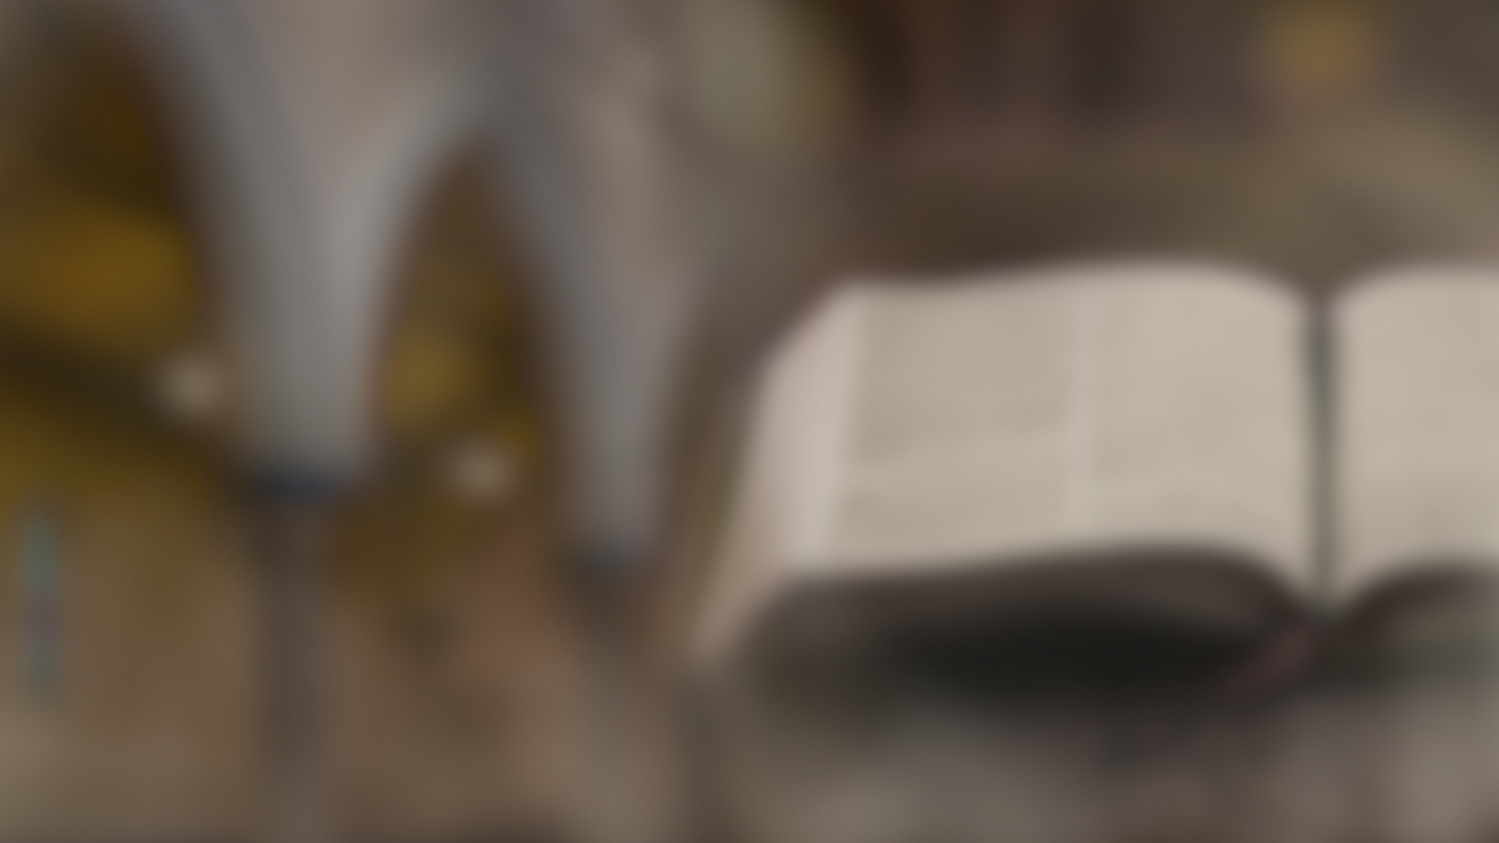
uNANG PAGBASA
First reading
[Enter Reading Here]

Slide 24
Salamat sa Diyos!
Thanks be to God!

Slide 26
Salmong tugunan
Responsorial psalm
[Enter Psalm here]

Slide 28
Ikalawang pagbasa
Second reading
[Enter text here]

Slide 29
Salamat sa Diyos!
Thanks be to God!

Slide 31
Mabuting balita
Gospel
[Enter Gospel Verse here]

Slide 32
Tugon:
Opo, itinatakwil namin

Slide 33
Tugon:
Opo, sumasampalataya kami

Slide 34
Sumasampalataya ako
I believe

Slide 35
Sa Diyos Amang makapangyarihan sa lahat
in God the Father almighty

Slide 36
na may gawa ng langit at lupa
The maker of heaven and earth

Slide 37
Sumasampalataya ako kay Hesukristo
I believe in Jesus Christ

Slide 38
iisang Anak
ng Diyos, Panginoon nating lahat
His only Son, our Lord

Slide 39
Nagkatawang-tao siya lalang ng Espiritu Santo
Who was conceived by the Holy Spirit

Slide 40
ipinanganak ni Santa Mariang Birhen
Born of the Virgin Mary

Slide 41
Pinagpakasakit ni
Poncio Pilato,
Suffered under Pontius Pilate

Slide 42
ipinako sa krus,
namatay, inilibing
Was crucified, died and was buried.

Slide 43
Nanaog sa kinaroroonan ng mga Yumao
he descended into hell.

Slide 44
Nang may ikatlong
araw nabuhay na mag-uli
on the third day he rose again from the dead.

Slide 45
Umakyat sa langit
He ascended into heaven

Slide 46
Naluluklok sa kanan
is seated at the right hand

Slide 47
ng Diyos Amang makapangyarihan sa lahat
of God the Father almighty

Slide 48
Doon magmumula ang paririto at huhukom
From there he will come to judge

Slide 49
sa nangabubuhay
at nangamatay na tao
The living and the dead

Slide 50
Sumasampalataya naman ako sa Diyos Espiritu Santo
I believe in the Holy Spirit

Slide 51
Sa banal na Simbahang Katolika
the holy catholic Church

Slide 52
sa kasamahan ng mga banal
the communion of saints

Slide 53
sa kapatawaran ng mga kasalanan,
the forgiveness of sins

Slide 54
sa pagkabuhay na muli ng nangamatay na tao,
the resurrection of the body

Slide 55
at sa buhay na walang hanggan. Amen
and live everlasting. AMEN

Slide 57
Panalangin ng bayan
Prayers of the faithful
[Enter response here]

Slide 58
Aba Ginoong Maria, napupuno ka ng grasiya
Hail Mary, full of grace

Slide 59
Ang Panginoong Diyos ay sumasaiyo
the Lord is with thee

Slide 60
Bukod kang pinagpala sa babaeng lahat,
Blessed art thou among women

Slide 61
At pinagpala rin naman ang anak mong si Hesus
and blessed is the fruit of thy womb, Jesus.

Slide 62
Santa Maria, Ina ng Diyos
Holy Mary, Mother of God

Slide 63
Ipanalangin mo kaming makasalanan
pray for us sinners

Slide 64
Ngayon at kung kami'y mamamatay. AMEN
now and at the hour of our death. AMEN

Slide 66
Offertory Song Here

Slide 68
Tanggapin nawa ng Panginoon
May the Lord accept

Slide 69
itong paghahain sa iyong kamay
the sacrifice at your hands

Slide 70
Sa kapurihan niya at karangalan
For the praise and glory of HIS name

Slide 71
sa ating kapakinabangan
For our good

Slide 72
at sa buong
Sambayanan niyang banal
And the good of all HIS holy church

Slide 74
Lahat (All)
At Sumaiyo rin
And with your spirit

Slide 75
Lahat (All)
Itinaas na namin sa Panginoon
We lift them up to the LORD

Slide 76
Lahat (All)
Marapat na siya ay pasalamatan
It is right and just (to give Him thanks)

Slide 78
Santo, Santo, Santo
Holy, Holy, Holy

Slide 79
Diyos Makapangyarihan
Lord God of hosts

Slide 80
Puspos ng l’walhati ang langit at lupa
Heaven and earth are full of your glory

Slide 81
Hosana, hosana sa kaitaasan
Hosanna, Hosanna in the highest

Slide 82
Pinagpala ang narito sa ngalan ng Panginoon
Blesses is He who comes in the name of the LORD

Slide 83
Hosana, hosana sa kaitaasan
Hosanna, Hosanna in the highest

Slide 84
Hosana, hosana sa kaitaasan
Hosanna, Hosanna in the highest

Slide 86
Si Kristo ay gunitain
Let’s remember Christ

Slide 87
Sarili ay inihain
For HE has served Himself

Slide 88
Bilang pagkai’t inumin
As a meal for us to partake

Slide 89
Pinagsasaluhan natin
For us, HIS own people

Slide 90
Hanggang sa S’ya’y dumating
Until the time HE comes

Slide 91
Hanggang sa S’ya’y dumating
Until the time HE comes

Slide 92
Aming ipinahahayag
We declare

Slide 93
Na namatay ang ‘yong Anak
That your Son died

Slide 94
Nabuhay bilang Mesiyas
Lived as a messiah

Slide 95
At magbabalik sa wakas
And will return at last

Slide 96
upang maghayag sa lahat
to be revealed to all

Slide 97
Si Kristo’y namatay
Christ has died

Slide 98
Si Kristo’y nabuhay
Christ has risen

Slide 99
Si Kristo ay babalik sa wakas ng panahon
Christ will come again

Slide 100
Santo, Santo, Santo
Holy, Holy, Holy

Slide 101
Panginoong Diyos ng mga hukbo
Lord God of hosts

Slide 102
Napupuno ang langit at lupa ng kadakilaan mo
Heaven and earth are full of your glory

Slide 103
Osana, Osana sa kaitaasan
Hosanna, Hosanna in the highest

Slide 104
Pinagpala ang naparirito
Blessed is He who comes

Slide 105
Sa ngalan ng Panginoon
In the name of the Lord

Slide 106
Osana, Osana sa kaitaasan
Hosanna, Hosanna in the highest

Slide 108
Ama Namin,
sumasalangit ka.
Our Father, who art in heaven

Slide 109
Sambahin ang ngalan mo
Hallowed be thy name

Slide 110
Mapasaamin ang
kaharian Mo
Thy kingdom come

Slide 111
Sundin ang loob mo dito sa lupa
Thy will be done on earth

Slide 112
para nang sa langit
as it is in heaven

Slide 113
Bigyan mo kami ngayon
Give us this day

Slide 114
ng aming kakanin sa araw-araw
our daily bread

Slide 115
At patawarin mo kami sa aming mga sala
and forgive us our trespasses

Slide 116
Para nang pagpapatawad namin sa nagkakasala sa amin
as we forgive those who trespass against us

Slide 117
At huwag mo kaming ipahintulot sa tukso
And lead us not into temptation

Slide 118
At iadya mo kami sa lahat ng masama
but deliver us from evil.

Slide 120
Sapagkat sa’yo ang kaharian
For the the kingdom

Slide 121
Kapangyarihan, at kapurihan
The power and glory are yours

Slide 122
magpakailanman
Now and forever

Slide 123
Sapagkat sa’yo ang kaharian
For the the kingdom

Slide 124
Kapangyarihan, at kapurihan
The power and glory are yours

Slide 125
Ngayon at magpakailanman
Now and forever

Slide 127
Kordero ng Diyos, na nag-aalis
Lamb of God who takes away

Slide 128
ng mga kasalanan ng sanlibutan
the sins of the world

Slide 129
Maawa ka sa amin
Have mercy on us

Slide 130
Kordero ng Diyos, na nag-aalis
Lamb of God who takes away

Slide 131
ng mga kasalanan ng sanlibutan
the sins of the world

Slide 132
Maawa ka sa amin
Have mercy on us

Slide 133
Kordero ng Diyos, na nag-aalis
Lamb of God who takes away

Slide 134
ng mga kasalanan ng sanlibutan
the sins of the world

Slide 135
Ipagkaloob mo sa amin ang kapayapaan
Grant us peace

Slide 137
Panginoon, hindi ako karapat-dapat
LORD, I am not worthy

Slide 138
na magpatuloy sa iyo
That you should enter under my roof

Slide 139
ngunit sa isang salita mo lamang
but only say the word

Slide 140
ay gagaling na ako
and my soul shall be healed

Slide 141
COMMUNION SONG TITLE
Communion Song Here

Slide 144
Final Song Here

